Slide 1
State Ethics Commission
Conflict of Interest Law Seminar
Presenter: David Giannotti, Chief
Public Education and Communications Division
State Ethics Commission
617-371-9505
David.Giannotti@mass.gov

Slide 2
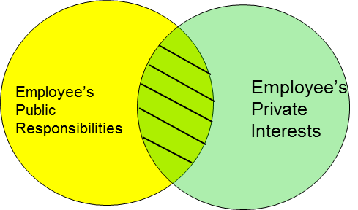
State Ethics Commission Conflicts 101
Professional Life vs. Personal Life
Focus of the Conflict of Interest Law

Slide 3
State Ethics Commission
State Ethics Commission
Is a five-member, independent, non-partisan state agency whose members are appointed by the Governor, the Attorney General and the Secretary of State
Provides advice, education and enforcement of M.G.L. c. 268A and 268B
Has jurisdiction over all state, county and municipal employees and volunteers, paid or unpaid, full-time, part-time or intermittent

Slide 4

State Ethics Commission
Website
www.mass.gov/orgs/state-ethics-commission
Educational materials
Formal Legal Opinions
Enforcement Decisions
Disclosure Forms
Links to the Online Training Program and Summary of the conflict of Interest Law for Municipal Employees

Slide 5
State Ethics Commission
A Municipal Employee is defined as
A Person
Performing services for or holding a municipal office, position, or employment in a municipal agency,
Whether by election, appointment, contract or engagement,
Whether serving with or without compensation,
On a full-time, part-time, intermittent, or consultant basis,
Excludes town meeting members and charter commission members.

Slide 6

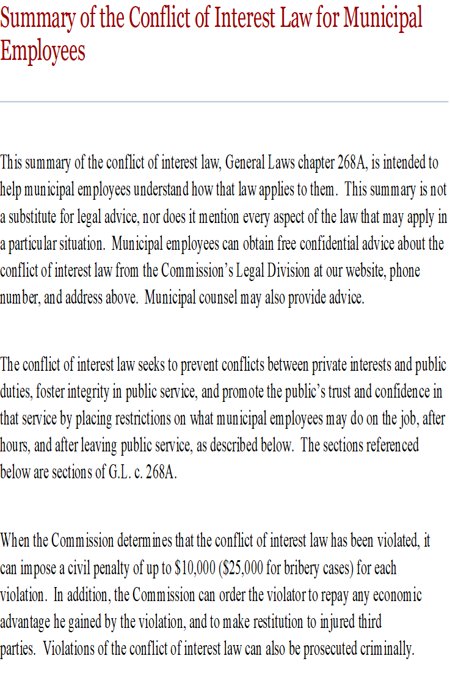
State Ethics Commission
Conflict of Interest Law Educational Requirements
Online Training Program
Summary of the Conflict of Interest Law

Slide 7

State Ethics Commission
Obtaining Legal Advice
Speak to the Attorney of the Day
Advice is confidential
Advice can be given by telephone (617) 371-9500
Online request for advice, www.mass.gov/orgs/state-ethics-commission
No third party or past conduct advice given
Disclosure forms available on the website

Slide 8
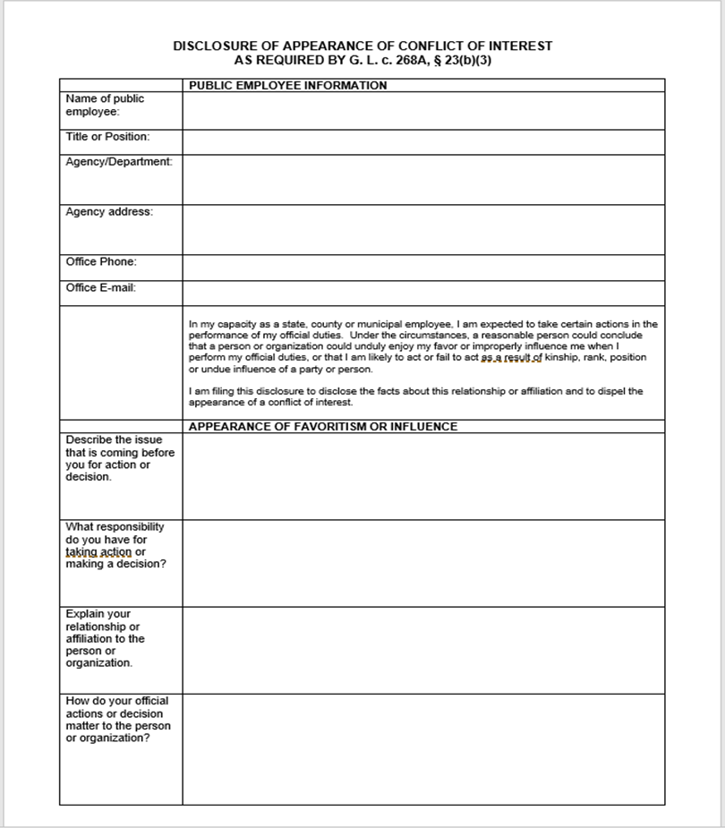
State Ethics Commission
Conflict of Interest Law Disclosures
Must be in writing
Must contain all relevant facts
Must be submitted in advance
Town employees file with their Appointing Authority
Elected Town officials file with the Clerk’s office
Disclosures are public records

Slide 9



State Ethics Commission
Gift Restriction Rules
Bribery: prohibits corrupt gifts, offers, and promises given to influence official acts (Quid Pro Quo).
Gifts/Gratuities: prohibits gifts valued at $50 or more and given because of official acts performed or to be performed.
Gifts: prohibits gifts valued at $50 or more and given because of official position.

Slide 10
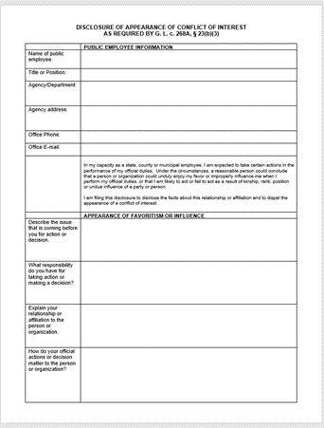
State Ethics Commission
Gift Restriction Rules
Section 23(b)(3)- Standards of Conduct: gifts valued at less than $50 are not prohibited, but if the receipt of a gift creates the appearance that the town employee could be improperly influenced in the performance of official duties, a written disclosure is required.

Slide 11



State Ethics Commission
Gifts That May Be Prohibited
Meals
Event Tickets (Advisory 04-1)
Free Travel or Expense Reimbursements
Gift Certificates
Floral Arrangements/Fruit Baskets
Lottery Tickets
Gifts offered through sales promotions

Slide 12
State Ethics Commission
Regulatory Exemptions relating to Gift Restrictions
(Disclosure and Prior Approval Required in Certain Circumstances)
Travel Expenses where the purpose of the travel serves a legitimate public purpose
Incidental Hospitality that serves a public purpose
Random Drawings
Unsolicited Perishable Items
Advisory 19-1: Gifts and Gratuities

Slide 13
State Ethics Commission
Regulatory Exemptions relating to Gift Restrictions
(Disclosure and Prior Approval Required in Certain Circumstances)
Passes to School Events Provided by the School District
Class Gifts to Teachers
Public Employee Discounts and Waived Membership Fees
Gifts Among Public Employees
Retirement Gifts

Slide 14
State Ethics Commission
Nepotism/Self-Dealing
A town employee may not participate in matters in which he, his immediate family, a partner, a business organization with which he has certain affiliations or someone with whom he is negotiating for prospective employment has a financial interest.
Disclosure filed with the appointing authority/Determination by the appointing authority
No exemption available for elected town officials
Financial interests of town employees who are abutters or competitors

Slide 15
State Ethics Commission
Nepotism: Definition of Immediate Family Members
Both Sets of Parents
You
Your Spouse
Siblings
Siblings
Your Children

Slide 16
State Ethics Commission
BOARD MEMBERS: THE RULE OF NECESSITY
AVAILABLE TO ELECTED BOARDS ONLY
THE BOARD CANNOT ACHIEVE A QUORUM
NO OTHER BOARD IS AVAILABLE TO DECIDE THE ISSUE
BOARD SHOULD OBTAIN LEGAL ADVICE
BOARD MEMBERS WILL NEED TO DISCLOSE CONFLICTS IN THE MEETING MINUTES
Advisory 05-05: The Rule of Necessity

Slide 17
State Ethics Commission
BOARD MEMBERS: IF YOU NEED TO ABSTAIN?
CAN I REMAIN AT THE TABLE?
CAN I SIT IN THE AUDIENCE?
MUST I LEAVE THE ROOM?

Slide 18
State Ethics Commission
Code of Conduct
A town employee shall not knowingly:
Act in a manner such that a reasonable person would conclude that he or she might act with bias
One-step written disclosure to dispel appearance of conflict
Use official position to secure unwarranted privileges for him or others.
Use public resources for private or personal use or political activity.
Disclose confidential information.

Slide 19

State Ethics Commission
Code of Conduct: Political Activity
Soliciting campaign support from colleagues, subordinates or constituents
Campaign activities in public buildings
Cannot use public resources for political purposes
Advisory 11-1: Public employee political activity

Slide 20

State Ethics Commission
Code of Conduct: Private Commercial Relationships
Advisory 14-1: Public employees’ private business relationships and other private dealings with those over whom they have official authority or with whom they have official dealings

Slide 21

State Ethics Commission
Divided Loyalties
While a town employee, unless you are a special municipal employee:
You may not represent 3rd party interests before any town board, even if you are not paid.
You may not be paid by anyone to work on any matters in which any agency of the town is a party or has a direct and substantial interest.

Slide 22

State Ethics Commission
Divided Loyalties
Positions classified as special municipal employees are less restricted
Town employees may always represent their own interests
Contractors/Consultants cannot compensate a town employee to work on any project where the conflict of interest law restricts the town employee

Slide 23
State Ethics Commission
Divided Loyalties: Special Municipal Employees
Positions that have been expressly classified by the Board of Selectmen
Are unpaid, or
Compensated for less than 800 hours in a year, or
By terms, classification or conditions of employment, permits personal or private employment during normal working hours
(Generally can include members of boards and committees)

Slide 24
State Ethics Commission
Regulatory Exemption related to Divided Loyalties restriction
Exemption to Permit Town Employees Who Are Parents to Advocate for Their Children (Disclosure Required for Supervisory Employees)
Exemption Permitting Persons Serving as Members of Town Boards Pursuant to a Legal Requirement That the Board Have Members With a Specified Affiliation to Participate Fully in Determinations of General Policy

Slide 25

State Ethics Commission
Financial Interests in Contracts
A town employee may not have a financial interest in a contract in which the town is an interested party.
Contracts to provide goods or services
Multiple positions, one of which is paid
“Inside Track” issues

Slide 26

State Ethics Commission
Financial Interests in Contracts
A town employee may not have a financial interest in a contract in which the town is an interested party.
Law applies less restrictively to designated “special” municipal employees
Restriction does not apply to elected or unpaid positions
Town employees can also serve on the Board of Selectmen
Other exemptions are available

Slide 27
State Ethics Commission
Restrictions on Appointment
Board members are ineligible for appointment to positions supervised by their board until 30 days after they resign from the board.
Town employees who also serve on the board of selectmen are ineligible for any other appointment to another town position while a selectman and for 6 months thereafter.
Housing Authority employees who also serve as elected town officials are ineligible for appointment to any other town position until 6 months after they leave the elected position.

Slide 28

State Ethics Commission
Former Town Employees: Revolving Door Restrictions
The forever ban
A former town employee is prohibited from receiving compensation from or representing a third party in any particular matter in which he participated as a town employee.
The one year cooling off period
A former town employee is prohibited for one year from appearing personally on behalf of a third party if, within two years prior to his last day of town service, the matter was under his official responsibility.

Slide 29



State Ethics Commission
Finally:
When in doubt . . .
If a bell goes off or a flag goes up. . . CALL
(617) 371-9500
(800) 485-4766
Visit: www.mass.gov/orgs/state-ethics-commission

