Slide 1
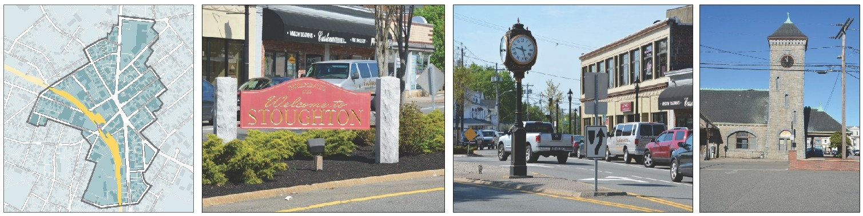
Stoughton Redevelopment Authority
Downtown Stoughton Redevelopment Plan (SDRP)
February 13, 2018

Slide 2
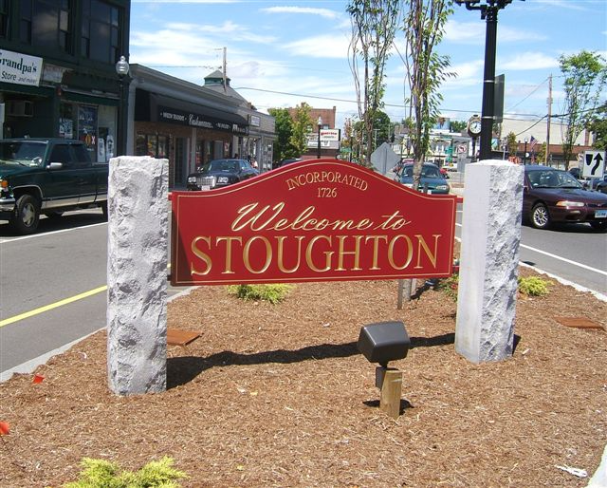
STOUGHTON REDEVELOPMENT AUTHORITY
2016 Membership
Michael Barrett, Chairman
Louis F. Gitto, Vice Chairman
Forrest Lindwall, Treasurer
Carlos Vargas
Cheryl Barrett, Secretary
2018 Membership
Michael Barrett, Chairman
Louis F. Gitto, Vice Chairman
Forrest Lindwall, Treasurer
Pam Lennon Carr
Helder Resendes
Cheryl Barrett, Secretary

Slide 3
Special Thanks to the following:
CITIZENS ADVISORY GROUP
Steven Bernstein Sung Pak
Paul Carpinella Nick Pirelli
Pam Lennon Carr Katherine Price
George Dyroff Noreen Ruggiero
Dori Frankel Francois Sarofeen
Joyce Husseini Michael Sullivan
Kevin Kosh Stanley Zoll
Janice McKenna
Town Officials & Consultants
  Michael Hartman, Town Manager
  Noreen O'Toole, Town Planner
  Pamela McCarthy, Economic Development Coordinator
  Marc Tisdelle, P.E. Town Engineer
  Howard/Stein-Hudson Associates, Inc. (Town Square Traffic Improvements Project)
  Brown Walker Planners, Inc. (Master Plan)
  McCabe Enterprises LLC (economic development reports)

Slide 4
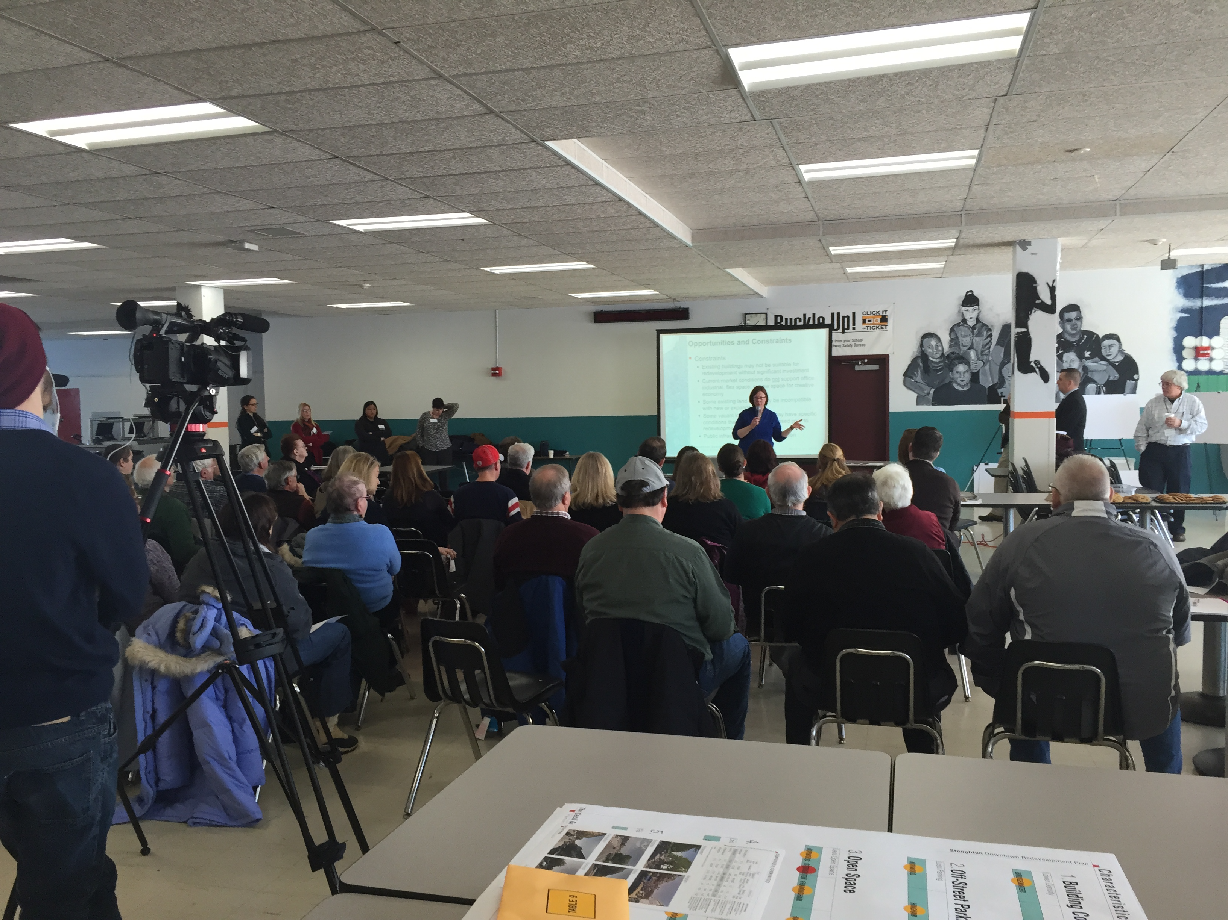
Stoughton Downtown Redevelopment Plan (SDRP) Timeline
April 2014 – RFP Issued
June 2014 – Consultant Selected
July 2014 through 2016
  17 meetings with Stakeholders
  4 Meetings with Town Officials
  5 Advisory Group Meetings
  3 Public Forums
  Plan Development
December 2016 – Plan Delivery

Slide 5
Original Purpose of the SDRP
To identify and clarify the role of the Stoughton Redevelopment Authority (SRA) as an effective partner with other Town Boards and Committees in the revitalization of the Downtown
To identify specific actions that could be undertaken by the SRA to address existing conditions in the Downtown in terms of redevelopment of land and buildings
Recommended as an implementation action of the Master Plan
Initially proposed as an urban renewal plan under MGL Chapter 121B

Slide 6
Findings of the SDRP
During the study process for the Stoughton Downtown Redevelopment Plan (SDRP), no specific project emerged that had the consensus of the community and elected officials.
The SDRP, as presented, does not include a specific urban renewal project or identify a specific public action related to land development as required by the legislation.
In other words, the SDRP is not an urban renewal plan - However it does follow the requirements of the Department of Housing and Community Development (DHCD).

Slide 7
Focus on Key Questions
What is a redevelopment authority and what authority could it exercise if it had a full urban renewal plan?
What is the advantage of having a redevelopment authority undertake real estate development?
What are the roles and responsibilities of the various Town bodies in terms of redevelopment?
Is having a Redevelopment Authority in Stoughton helpful, useful, and/or necessary.
Are there alternatives to having a Redevelopment Authority?

Slide 8
More Specifically
What can the Stoughton Redevelopment Authority do under this SDRP?
What is the Stoughton Redevelopment Authority not allowed to do under this SDRP?

Slide 9
What a Redevelopment Authority Can Do
A Redevelopment authority may:
Undertake specific development projects
Work to create the conditions under which the private market will undertake those projects

Slide 10
Redevelopment Authority Tools
Redevelopment Authority tools to encourage private investment include the following:
Establish regulatory controls that guide development under the goals and objectives of a redevelopment plan.
Undertake public infrastructure improvements that create incentives for the private market to invest.
Assemble parcels that are too small to be economically developed into a larger parcel for development.

Slide 11
Stoughton Redevelopment Authority
Not an agency of the Town, however four of the members are elected by Stoughton residents.
By design, Redevelopment Authorities have a high degree of autonomy when it comes to planning and implementing redevelopment and revitalization projects
The development and approval of an Urban Redevelopment Plan by the Department of Housing and Community Development (DHCD) is necessary for a Redevelopment Authority to undertake a specific project.

Slide 12
Stoughton Redevelopment Authority
The SRA has continued to work with and invest in the Town,
We helped fund the Rapid Response Beacons,
We have helped fund studies for the Economic Development Coordinator .
During the SDRP process we had a community outreach program and provided funds for the Friends of Stoughton Center and Farmers Market.
We provided funds to support the Community Development Block Grant.
We have had discussions with the Town regarding support for a storefront and façade program.

Slide 13
The Role of the SRA
Under the SDRP, the SRA may:
Acquire, lease, and dispose of land
Issue bonds, borrow money, and invest funds
Receive grants and loans
Accept gifts or requests
Conduct additional planning studies to identify a specific project or projects

Slide 14
The Role of the SRA
Under the SDRP, the SRA may not do the following
We cannot acquire properties using the process of eminent domain
We cannot define and administer regulatory controls on development within an the redevelopment area.
The above actions require a fully approved Urban Renewal Plan including Planning Board Certification, Board of Selectman and DHCD approval.

Slide 15
Recommended Future Actions (Public Forum Exercises)
The good news is that we can do most of these today
Work with other Town Boards and Committees to be an effective partner in the continued revitalization of the Downtown
Purchase property or acquire property through gifts
Develop land or buildings by itself or in partnership with a designated developer
Assemble smaller parcels of land within the Downtown to create lots that are developable under the existing zoning
Partner with the Planning Board to develop additional regulatory controls for the area that would be administered by the Planning Board
Act as the Town’s parking authority
Provide funding for storefront and façade improvements

Slide 16
Remaining Steps to complete a full fledged Urban Renewal Plan
The remaining portions of the draft urban renewal plan must be completed and the SRA must approve the plan and send it to the Planning Board, Town Counsel, and Board of Selectmen.
The Planning Board must determine whether or not the urban renewal plan is consistent with the requirements of the municipality's comprehensive plan, in this case, the Stoughton Master Plan.
Town Counsel must determine whether or not the plan conforms with all applicable laws.
The Board of Selectmen must approve a draft urban renewal plan for submission to DHCD.
DHCD must review and approve the plan.
The SRA cannot undertake actions under an urban renewal plan that has not been approved by DHCD.

Slide 17
Priority Actions (Public Forum Exercises)
Assemble land for private developers to redevelop/Redevelop land owned by the Town of Stoughton
(Each action was identified as the number one priority by five respondents. Both were also identified as priority number two by three respondents each.)
Develop regulatory controls, such as design guidelines, in partnership with the Planning Board (
Identified as the number one priority by four respondents; identified as the number two priority by three respondents.)
Provide funding for storefront and façade improvements/Acquire parcels by eminent domain in order to redevelop them
(Each action was identified as the number one priority by three respondents, identified as the number two priority by only one respondent each)

Slide 18
Potential Projects for the SRA
Sites that could benefit from coordinated action from the Board of Selectmen, the SRA, and the Planning Board.
These potential projects are discussed in detail in the SDRP
  The United States Post Office
  The historic train depot
  The fire station on Freeman Street
  The police station on Rose Street
  The municipal parking lot on Freeman Street

Slide 19
Next Steps
Board of Selectmen
Identify and prioritize specific project(s) to include in the redevelopment plan.
Identify tasks for the SRA and other Town Boards to assist in meeting these priorities.
Coordinate the approval process with the Planning Board and DHCD

Slide 20
Thank You
Additional Information
More detailed information about the project is available at:
http://www.stoughton.org/Redevelopment
https://www.facebook.com/groups/StoughtonMARA/
The End

